Slide 1

PHP ARRAY

Slide 2
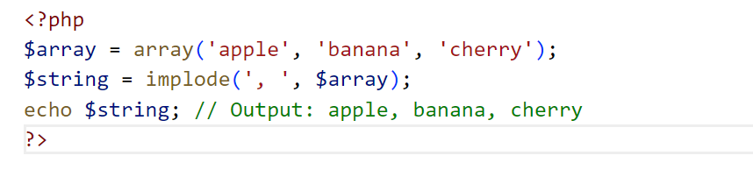
implode(): This function is used to join array elements with a string and create a single string from the array elements.

Slide 3
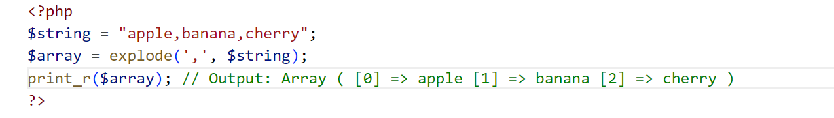
explode(): This function is used to split a string into an array by a specified delimiter.

Slide 4
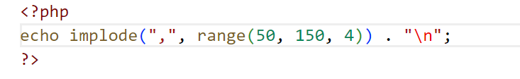
Write a PHP script which displays all the numbers between 50 and 150 that are divisible by 4

Slide 5
Write a PHP script that take user name as input and determines the nature of the first letter of a person's name – whether it's a vowel or a consonant.
Kavya wants to throw a pizza party with her friends. She cooks pizza for them; now she wants her pizzas divided into eight slices each and distributed evenly among her friends.
Create a function that
• It takes a number of pizzas and a number of friends.
• and returns the number of slices that will be left over if each person takes an equal number of slices.

Slide 6
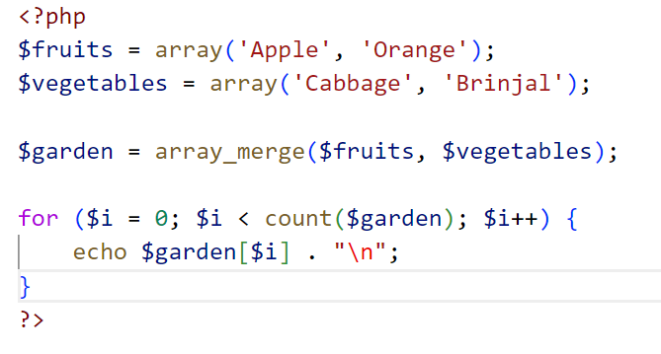
PHP program to merge two array

Slide 7
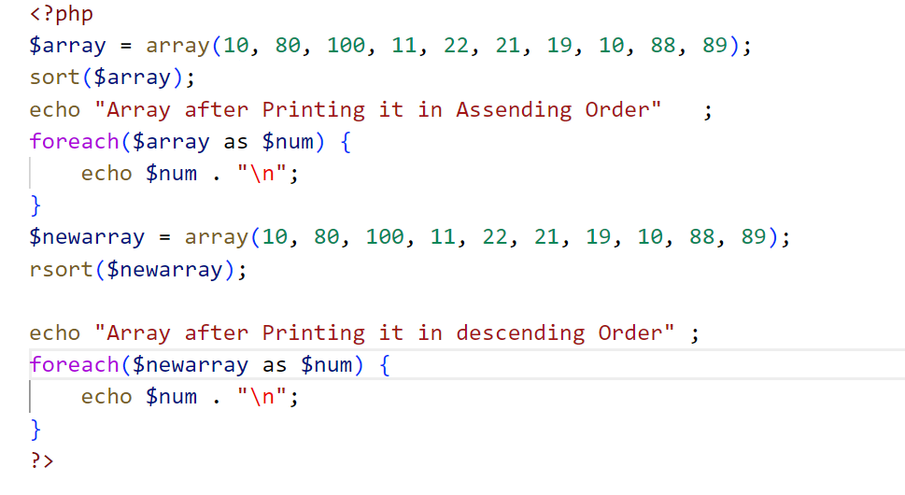
PHP program to sort an integer array in ascending and descending order

Slide 8
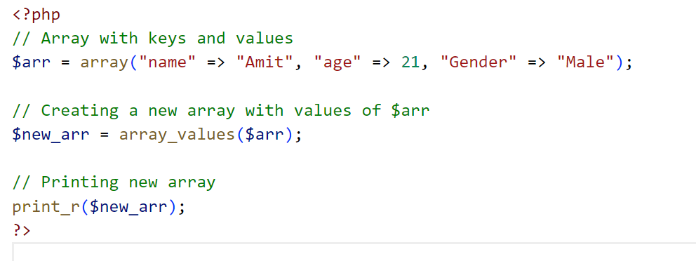
How to get the only values from an associative array in PHP?

Slide 9
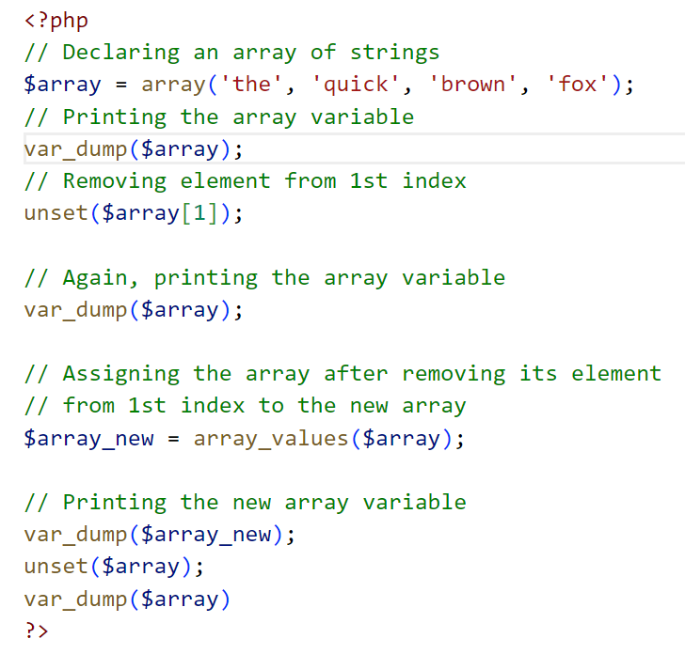
Delete an element from an array using unset() function

Slide 10
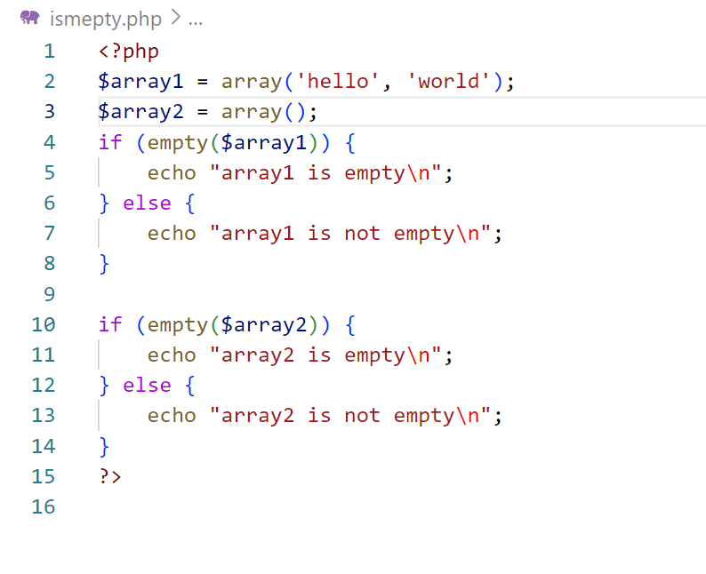
Check if an array is empty or not in PHP

Slide 11
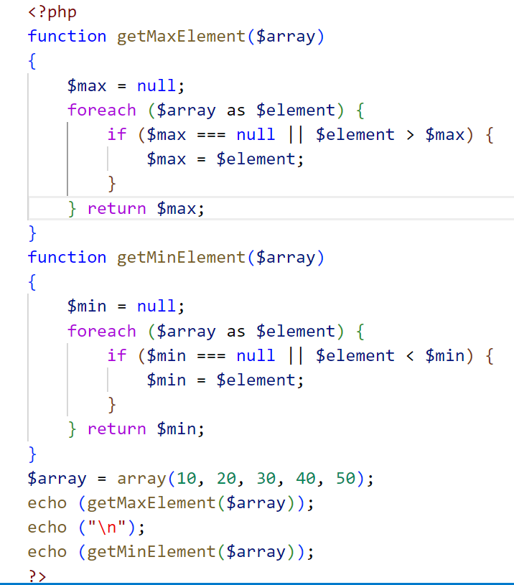
PHP program to find the maximum and minimum element of an array

Slide 12
You are building an e-commerce website. Implement a PHP script that simulates a shopping cart. Users can add and remove items from their cart. Create functions to:
Add an item to the cart.
Remove an item from the cart.
Calculate the total cost of items in the cart

Slide 13
Imagine you're managing the inventory of a store. Implement a PHP program that uses an array to keep track of product names, quantities, and prices. Write functions to:
Add a new product to the inventory.
Update the quantity of a product.
Calculate the total value of the inventory (quantity * price) and display it.

Slide 14
Create an array of student names and their corresponding grades. Write a PHP program to calculate and display the following statistics:
Average grade
Highest grade
Lowest grade
List of students who scored below a certain grade (e.g., below 70).

